Slide 1

DEPARTMENT OF ARTIFICIAL INTELLIGENCE AND DATA SCIENCE
Vision
To impart international quality education, promote collaborative research and graduate industry-ready engineers in the domain of Artificial Intelligence and Data Science to serve the society.

Slide 2
linear search
Binary search

Slide 3
linear search
A linear search scans one item at a time, without jumping to any item .
The worst case complexity is O(n), sometimes known an O(n) search
Time taken to search elements keep increasing as the number of elements are increased

Slide 4
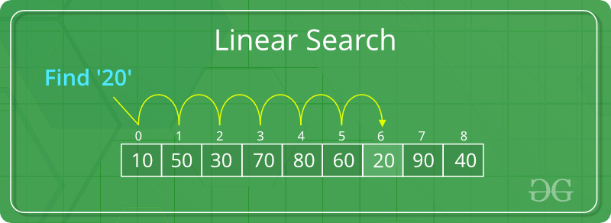
A simple approach is to do a linear search,
Start from the leftmost element of arr[] and one by one compare x with each element of arr[]
If x matches with an element, return the index.
If x doesn’t match with any of elements, return -1.

Slide 5
def search(arr, n, x):
for i in range(0, n):
if (arr[i] == x):
return i
return -1
arr = [2, 3, 4, 10, 40]
x = 10
n = len(arr)
# Function call
result = search(arr, n, x)
if(result == -1):
print("Element is not present in array")
else:
print("Element is present at index", result)

Slide 6
def search(arr, search_Element):
left = 0
length = len(arr)
position = -1
right = length - 1
for left in range(0, right, 1): # Run loop from 0 to right
if (arr[left] == search_Element): # If search_element is found with left variable
position = left
print("Element found in Array at ", position +1, " Position with ", left + 1, " Attempt")
break
if (arr[right] == search_Element): # If search_element is found with right variable
position = right
print("Element found in Array at ", position + 1, " Position with ", length - right, " Attempt")
break
left += 1
right -= 1
if (position == -1): # If element not found
print("Not found in Array with ", left, " Attempt")
arr = [1, 2, 3, 4, 5]
search_element = 5
search(arr, search_element) # Function call
Time Complexity : O(n)
Auxiliary Space: O(1)

Slide 7
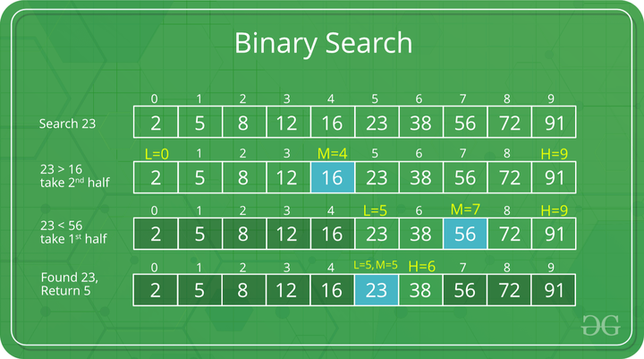
Binary search
Binary Search is a searching algorithm for finding an element's position in a sorted array by repeatedly dividing the search interval in half.
Implementation
Iterative Method
Recursive Method
Applications
In libraries of Java, .Net, C++ STL
While debugging, the binary search is used to pinpoint the place where the error happens.

Slide 8
Binary search algorithm :Iterative method
do until the pointers low and high meet each other.
mid = (low + high)/2
if (x == arr[mid])
return mid
else if (x > arr[mid]) // x is on the right side
low = mid + 1
else // x is on the left side
high = mid - 1

Slide 9
# Binary Search in python : Iterative method def binarySearch(array, x, low, high): # Repeat until the pointers low and high meet each other
while low <= high: mid = (low + high)//2
if array[mid] == x:
return mid elif array[mid] < x:
low = mid + 1 else:
high = mid - 1
return -1 array = [3, 4, 5, 6, 7, 8, 9]
x = 4 result = binarySearch(array, x, 0, len(array)-1)
if result != -1:
print("Element is present at index " + str(result))
else:
print("Not found")

Slide 10
Binary Search Algorithm: Recursive method
Compare x with the middle element.
If x matches with the middle element, we return the mid index.
Else If x is greater than the mid element, then x can only lie in the right half subarray after the mid element. So we recur for the right half.
Else (x is smaller) recur for the left half.

Slide 11
# Binary Search in python : Recursive method def binarySearch(array, x, low, high): if high >= low: mid = (low + high)//2
if array[mid] == x: # If found at mid, then return it
return mid
elif array[mid] > x: # Search the left half
return binarySearch(array, x, low, mid-1)
else:
return binarySearch(array, x, mid + 1, high) # Search the right half
else:
return -1
array = [3, 4, 5, 6, 7, 8, 9]
x = 4
result = binarySearch(array, x, 0, len(array)-1)
if result != -1:
print("Element is present at index " + str(result))
else:
print("Not found")
Time Complexities
Best case complexity: O(1)
Average case complexity: O(log n)
Worst case complexity: O(log n)
Space Complexity
The space complexity of the binary search is O(1).

Slide 12
Class assignment
Amazon/Microsoft problem statement
Amazon phone: Highest occurring item in a stream
Say on amazon website, a user gets to cast one vote for their favorite item. Given this data (which is sooo huge) find the top most voted item. Criteria Time: O(n) Space: O(1). You may try: 1)Hashmap 2)Divide the steam and pick top from each 3)Using Moore’s Voting Algorithm
Given a sorted array containing only 0s and 1s, find the transition point.
Input: N = 5 arr[] = {0,0,0,1,1} Output: 3 Explanation: index 3 is the transition point where 1 begins.
Given three arrays sorted in increasing order. Find the elements that are common in all three arrays.
Input: n1 = 6; A = {1, 5, 10, 20, 40, 80} n2 = 5; B = {6, 7, 20, 80, 100} n3 = 8; C = {3, 4, 15, 20, 30, 70, 80, 120} Output: 20 80 Explanation: 20 and 80 are the only common elements in A, B and C.
Expected Time Complexity: O(n1 + n2 + n3) Expected Auxiliary Space: O(n1 + n2 + n3)
Find the smallest positive number missing from an unsorted array
Input: N = 5 arr[] = {1,2,3,4,5} Output: 6 Explanation: Smallest positive missing number is 6.
Majority element : Given an array A of N elements. Find the majority element in the array. A majority element in an array A of size N is an element that appears more than N/2 times in the array.
Input: N = 3 A[] = {1,2,3} Output: -1 Explanation: Since, each element in {1,2,3} appears only once so there is no majority element.

Slide 13

Why Hashing is Needed?
After storing a large amount of data. Linear search and binary search perform lookups/search with time complexity of O(n) and O(log n) respectively.
As the size of the dataset increases, these complexities also become significantly high which is not acceptable.
We need a technique that does not depend on the size of data. Hashing allows lookups to occur in constant time i.e. O(1).
Hash Table
Hash table is a data structure which stores data in an associative manner. In a hash table, data is stored in an array format, where each data value has its own unique index/hash key value.
A lookup table with length 11 for a map containing items (1,D), (3,Z),(6,C), and (7,Q).
O(1) worst-case time

Slide 14
hash function
A hash function is used for mapping each element of a dataset to indexes in the hash table range [0,N −1], where N is the capacity of the bucket array for a hash table
Hashing
Hashing is a technique of mapping a large set of arbitrary data to tabular indexes using a hash function. It is a method for representing dictionaries for large datasets.

Slide 15
Hash code
hashCode returns an integer value, generated by a hashing algorithm. This integer need not be in the range [0,N −1], and may even be negative.
The set of hash codes assigned to keys should avoid collisions as much as possible
Types of hashcode
Bit Representation hash code : 32bit hash code
Polynomial hash code
Cyclic-Shift Hash Codes: polynomial hash code replaces multiplication by a with a cyclic shift of a partial sum by a certain number of bits
def hash code(s):
mask = (1 << 32) − 1 # limit to 32-bit integers
h = 0
for character in s:
h = (h << 5 & mask) | (h >> 27) # 5-bit cyclic shift of running sum
h += ord(character) # add in value of next character
return h

Slide 16
compression function
A compression function is one that minimizes the number of collisions for a given set of distinct hash codes.
The Division Method
A simple compression function is the division method, which maps an integer i to i mod N,
The MAD Method
It helps eliminate repeated patterns in a set of integer keys, is the Multiply-Add-and-Divide (or “MAD”) method.
This method maps an integer i to [(ai+b) mod p] mod N

Slide 17
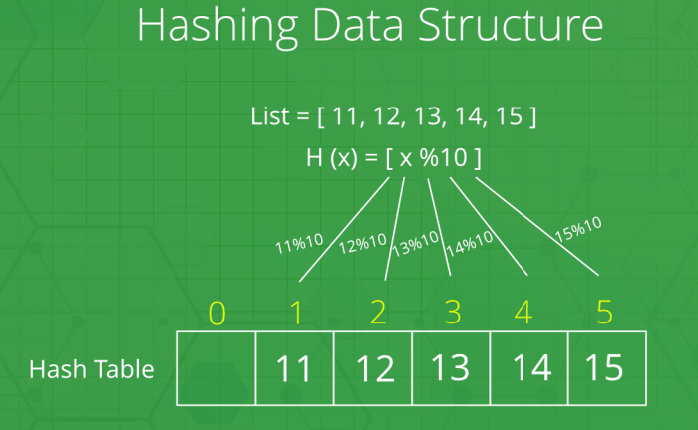
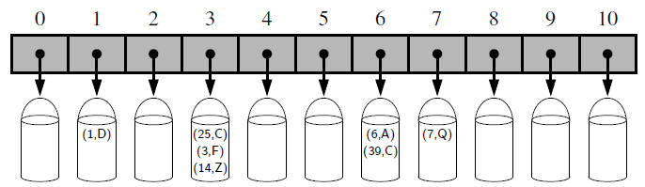
A bucket array of capacity 11 with items (1,D), (25,C), (3,F), (14,Z), (6,A), (39,C), and (7,Q), using a simple hash function

Slide 18
hash_table = [None] * 10 # Implementation of Hashtable using python
print (hash_table)
def hashing_func(key):
return key % len(hash_table)
# print the calculated hash key print (hashing_func(10)) # Output: 0
print (hashing_func(20)) # Output: 0
print (hashing_func(25)) # Output: 5
def insert(hash_table, key, value):
hash_key = hashing_func(key)
hash_table[hash_key] = value
insert(hash_table, 10, 'Nepal')
print (hash_table)
insert(hash_table, 25, 'USA')
print (hash_table)
['Nepal', None, None, None, None, None, None, None, None, None] ['Nepal', None, None, None, None, 'USA', None, None, None, None]

Slide 19
Collision Resolution
There are generally two ways to resolve a collision:
1. Linear Probing 2. Chaining
1. Linear Probing
One way to resolve collision is to find another open slot whenever there is a collision and store the item in that open slot. The search for open slot starts from the slot where the collision happened. It moves sequentially through the slots until an empty slot is encountered. The movement is in a circular fashion. Hence, covering the entire hash table. This kind of sequential search is called Linear Probing.
2. Chaining
This allows multiple items exist in the same slot/index.
This can create a chain/collection of items in a single slot.
When the collision happens, the item is stored in the same slot using chaining mechanism.

Slide 20
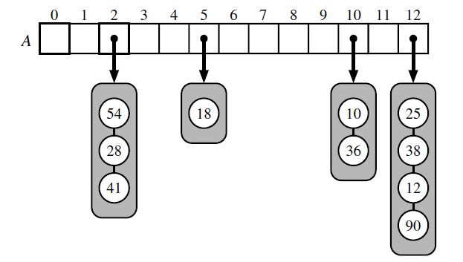
Chaining
This allows multiple items exist in the same slot/index.
This can create a chain/collection of items in a single slot.
When the collision happens, the item is stored in the same slot using chaining mechanism
The compression function is h(k)=k mod 13.

Slide 21
HashTable = [[] for _ in range(10)] # Creating Hashtable as a nested list
display_hash (HashTable)
def Hashing(keyvalue): # Hashing Function to return key for every value.
hash_key=keyvalue % len(HashTable)
return hash_key def insert(Hashtable, keyvalue, value): # Insert Function to add # values to the hash table
hash_key = Hashing(keyvalue)
Hashtable[hash_key].append(value)
def display_hash(hashTable): # Function to display hashtable
for i in range(len(hashTable)):
print(i, end = " ")
for j in hashTable[i]:
print("-->", end = " ")
print(j, end = " ")
print()
insert(HashTable, 10, 'Allahabad')
insert(HashTable, 25, 'Mumbai')
insert(HashTable, 20, 'Mathura')
insert(HashTable, 9, 'Delhi')
insert(HashTable, 21, 'Punjab')
insert(HashTable, 21, 'Noida') display_hash (HashTable)
# Implementation of Hashtable using python
0 --> Allahabad --> Mathura
1 --> Punjab --> Noida
2
3
4
5 --> Mumbai
6
7
8
9 --> Delhi

Slide 22
Linear Probing
One way to resolve collision is to find another open slot whenever there is a collision and store the item in that open slot. The search for open slot starts from the slot where the collision happened. It moves sequentially through the slots until an empty slot is encountered. The movement is in a circular fashion. Hence, covering the entire hash table. This kind of sequential search is called Linear Probing.

Slide 23
class hashTable:
def _init_(self):
self.table = [None]*10 # initialize hash Table
self.elementCount =0
def hashFunction(self, key): # Find Hash code
return key % self.size
def insert(self, key, element): # inserts element into the hash table
position = self.hashFunction(key)
if self.table[position] == None:#checking if eth position is empty
self.table[position] = element
self.elementCount += 1
# collision occured hence we do linear probing
else:
while self.table[position] != None:
position += 1
self.table[position] = element
self.elementCount += 1

Slide 24
# method that searches for an element in the table returns position of element if found else returns False
def search(self, key):
position = self.hashFunction(key)
if(self.table[position] == element):
print("element found ")
return position
else:
print("element found ")
# method to display the hash table
def display(self):
print("\n")
for i in range(self.size):
print("Hash Value: "+i + "\t\t" + self.table[i])

Slide 25
# Function to implement the quadratic probing
def hashing(table, tsize, arr, N):
# Iterating through the array
for i in range(N):
# Computing the hash value
hv = arr[i] % tsize
# Insert in the table if there is no collision
if (table[hv] == -1):
table[hv] = arr[i]
else:
# If there is a collision iterating through all possible quadratic values
for j in range(tsize):
# Computing the new hash value
t = (hv + j * j) % tsize
if (table[t] == -1):
# Break the loop after inserting the value in the table
table[t] = arr[i]
break

Slide 26
Rehashing
load factor
if there are n entries and b is the size of the array there would be n/b entries on each index. This value n/b is called the load factor that represents the load that is there on our map.
Default Load factor=0.75
This Load Factor needs to be kept low, so that number of entries at one index is less and so is the complexity almost constant, i.e., O(1)

Slide 27
Rehashing can be done as follows:
For each addition of a new entry to the map, check the load factor.
If it’s greater than its pre-defined value (or default value of 0.75 if not given), then Rehash.
For Rehash, make a new array of double the previous size and make it the new bucketarray.
Then traverse to each element in the old bucketArray and call the insert() for each so as to insert it into the new larger bucket array.

Slide 28
def __setitem__(self, k, v):
j = self._hash_function(k)
self._bucket_setitem(j, k, v) # subroutine maintains self._n
if self._n > len(self._table) // 2: # keep load factor <= 0.5
self._resize(2 * len(self._table) - 1) # number 2^x - 1 is often prime
def __delitem__(self, k):
j = self._hash_function(k)
self._bucket_delitem(j, k) # may raise KeyError
self._n -= 1
def _resize(self, c):
"""Resize bucket array to capacity c and rehash all items."""
old = list(self.items()) # use iteration to record existing items
self._table = c * [None] # then reset table to desired capacity
self._n = 0 # n recomputed during subsequent adds
for (k,v) in old:
self[k] = v # reinsert old key-value pair

Slide 29
def _bucket_setitem(self, j, k, v):
found, s = self._find_slot(j, k)
if not found:
self._table[s] = self._Item(k,v) # insert new item
self._n += 1 # size has increased
else:
self._table[s]._value = v # overwrite existing

Slide 30
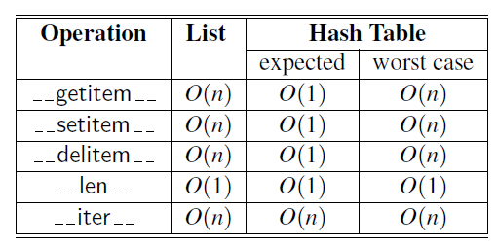
Efficiency of Hash Tables
If our hash function is good, then we expect the entries to be uniformly distributed in the N cells of the bucket array. Thus, to store n entries, the expected number of keys in a bucket would be n/N, which is O(1) if n is O(N). n/N is a load factor. The default load factor is 0.75
The costs associated with a periodic rehashing, to resize a table after occasional insertions or deletions can be accounted for separately

Slide 31
Class assignment
# Python3 implementation of the Quadratic Probing
Implement Phone Directory using Hashing
Find frequency of each element in given 3D Array. Given a 3D array of size N*M*P consisting only of English alphabet characters, the task is to print the frequency of all the elements in increasing order. If the frequency is the same, print them in lexicographic ordering.
Compare two files using Hashing in Python
Mid-Square hashing

Slide 32
References
https://www.geeksforgeeks.org/python-oops-concepts/
https://www.programiz.com/dsa/circular-queue
https://www.techiedelight.com/iterative-merge-sort-algorithm-bottom-up/
https://blog.chapagain.com.np/hash-table-implementation-in-python-data-structures-algorithms/
https://www.codingninjas.com/codestudio/library/load-factor-and-rehashing
https://onecompiler.com/python/3wq9gxuuy
Madhavan Mukund, Chennai Mathematical Institute, NPTEL MOOC on Programming Data Structure and Algorithms in Python
http://www.cse.unsw.edu.au/~cs2011/05s1/tut/solutions/tut08sol.html

